Slide 1
Tidal hypothesis of James jeans and Harold jeffreys
Sir james jeans, a british scientist, propounded his ‘tidal hypothesis’ to explain the origin of the earth in the year 1919 AD while another british scientist, Harold Jeffreys, suggested modification in the ‘tidal hypothesis’ in 1929 AD and thus made it more relevant and significant in the context of increasing knowledge of cosmogonic ideas of the 20th century.
Tidal hypothesis is one of the modern hypotheses of the origin of the earth and the solar system. Jeans postulated his hypothesis on the basis of certain self prove fact as given below……..

Slide 2
Facts
This is a dualistic concept ( where involving two heavenly bodies).
The solar system was formed from the sun and another intruding star.
In the beginning the sun was a big incandescent gaseous mass of matter.
Beside the sun, there was another star termed as ‘intruding star’ in the universe. This intruding star was much bigger in size than the primitive sun.
The primitive sun was stationary and was rotating on its axis.
The ‘intruding star’ star was moving along such a path in a such a way that it was come nearer to the primitive sun.

Slide 3
Facts
There was great impact of the tidal force of the intruding star on the surface of the primitive sun.
James jeans postulated that due to massive gravitational force of the ‘intruding star’ huge amount of matter was ejected from the primitive sun, which later on became the building material of future planets.
James Jeans assumed that the ‘ intruding star’ to be much bigger than the ‘primitive sun’. Therefore the gravitational pull of ‘intruding star’ more than ‘primitive sun, which caused ejection of matter from the ‘primitive sun’.
Secondly, there is an inverse relation between the gravitational force of the two stars and the distance between them.
It was in case of ‘intruding star’ and ‘primitive sun’ when ‘intruding star’ was coming closer to the ‘primitive sun’ and the gravitational force between them was also increasing.

Slide 4
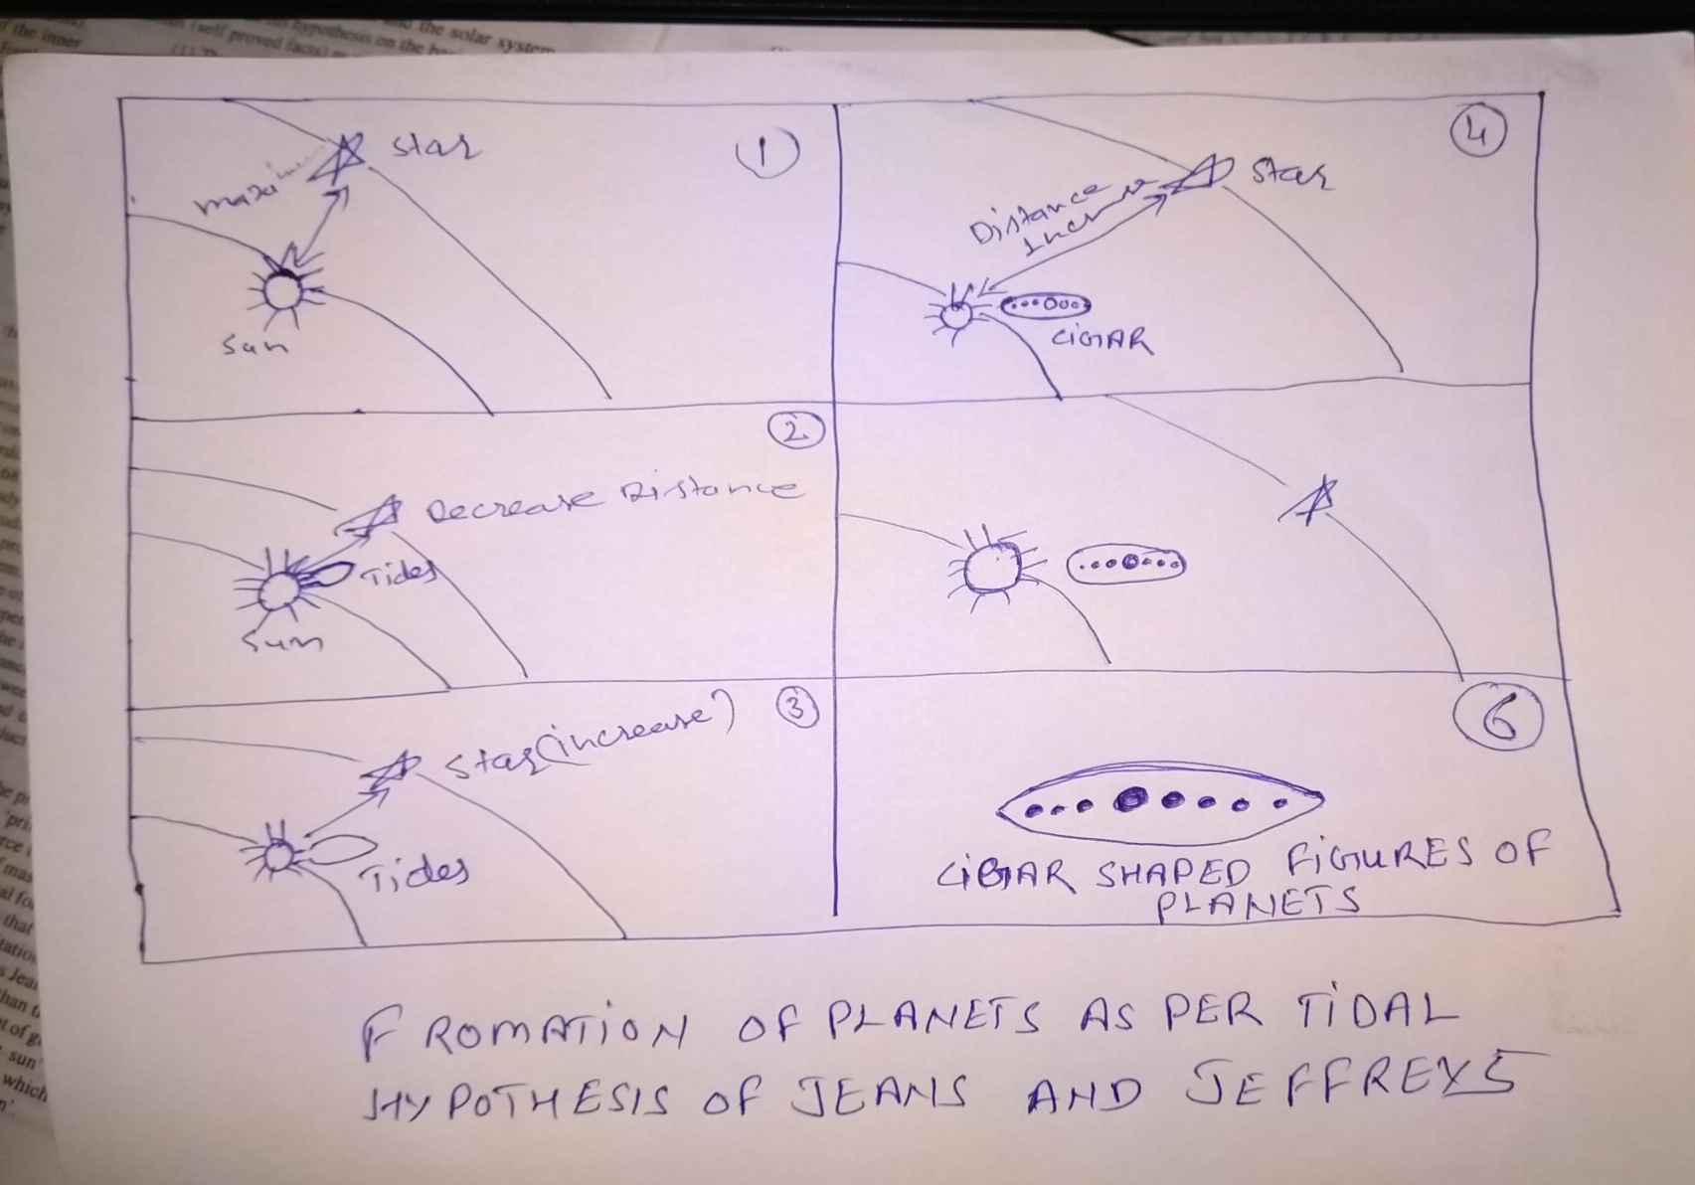
Evolution of filament (tides)

Slide 5
According to James jeans the ‘intruding star’ was continuously moving along such a path that it was coming nearer to the primitive sun and thus exerted gaseous tidal force on the surface of the primitive sun.
When the intruding star came nearest to the primitive sun’ its gravitational force become maximum, with a result a giant cigar-shaped tide, thousands of kilometers in length, was created on the outer surface of the primitive sun’ and ultimately huge mass of matter, in the cigar shaped ejected from the primitive sun’. James jeans called this cigar shaped matter as filament, which was much thicker in the centre and thinner and sharper at the ends.

